Slide 1

AIRPLANE CRASH ANALYSIS
Internship project by pooja upadhye with mentorness
BATCH NAME – MIP-DA-06

Slide 2

PROBLEAM STATEMENT
project focuses on conducting a comprehensive analysis of airplane crashes and fatalities spanning from 1980 to 2023. The dataset contains crucial information such as crash dates, locations, operators, flight details, aircraft types, and fatality statistics.
The goal is to leverage Tableau for interactive visualizations and in-depth insights to understand patterns, contributing factors, and trends in aviation incidents. The analysis aims to provide stakeholders with valuable information for enhancing aviation safety and mitigating risks.

Slide 3
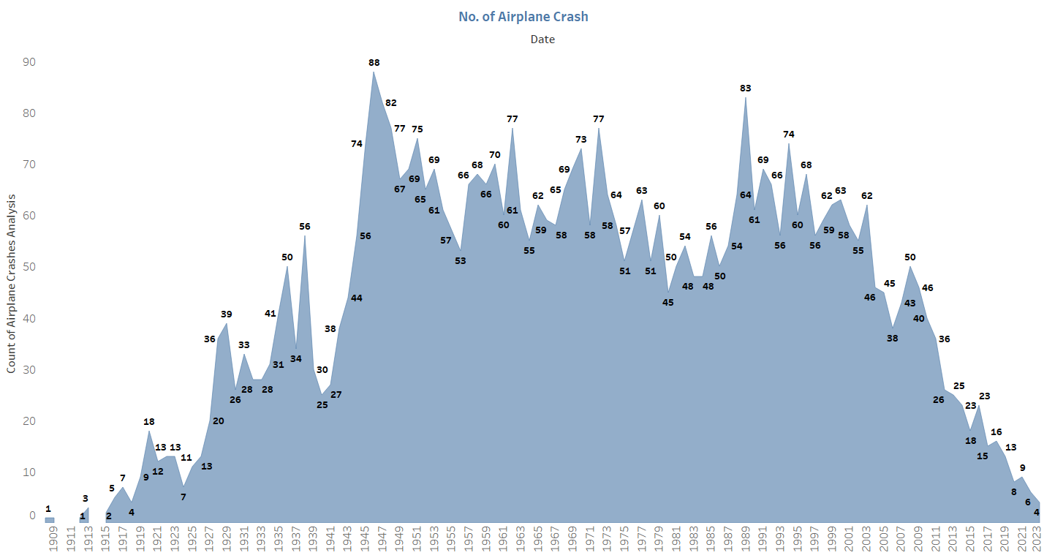
TEMPROAL ANALYSIS INSIGHT
Airplane Crashes Over The Years
Utilizing Tableau, we conducted a comprehensive examination of airplane crashes across various years, unveiling compelling insights.
For instance, our data revealed a notable observation: in 1946, the frequency of airplane crashes expanded rapidly to 88 incidents. This revelation underscores the significance of our analysis in decoding historical trends and informing future aviation safety measures.

Slide 4
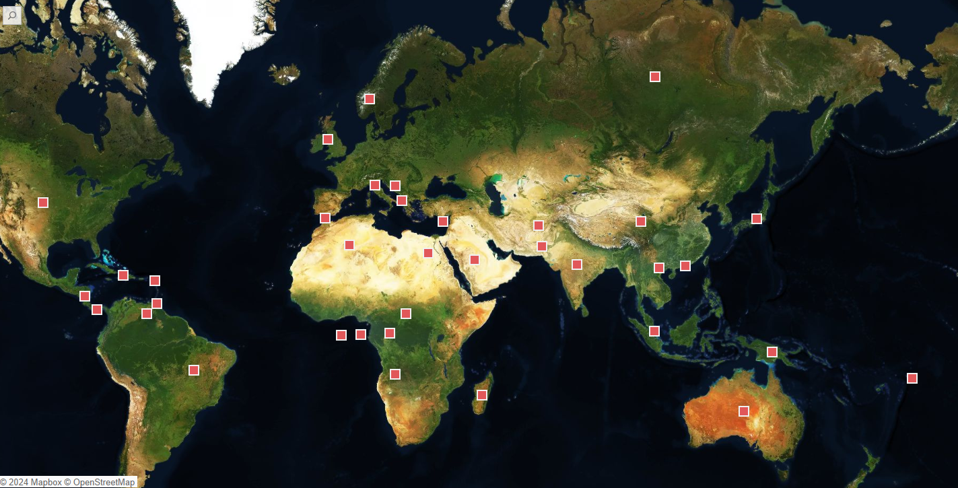
Geospatial Analysis insight
AIRPLANE CRASHES LOCATION ON MAP
During our spatial analysis of airplane crashes using Tableau, we discovered significant insights regarding crash locations.
Russia emerged as a prominent contributor recorded crashes, closely followed by Brazil, Australia incidents. Germany and France, colombia also made substantial contributions each accounting for 9 and more than crashes.
This geographic distribution sheds light on areas of heightened aviation risk, prompting a closer examination of safety protocols and prevention strategies in these regions.

Slide 5
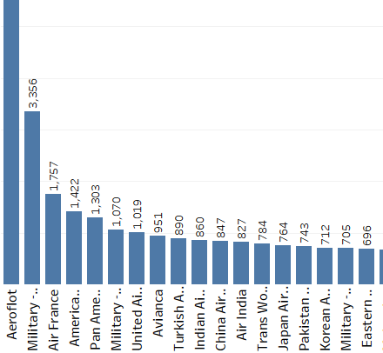
OPERATOR PERFORMANCE INSIGHT
Operator With Highest Number Of Incidents
In our comprehensive airplane crash analysis conducted with Tableau, we analyzed operators with higher incidence rates. Notably, Aeroflot stood out with the highest number of incidents, resulting in a total of 8,893 fatalities. Following closely behind were American Airlines, which recorded 4,311 fatalities, and United Airlines with 3,772 fatalities. Additionally, the U.S. Air Force's military operations reported 3,523 fatalities.

Slide 6
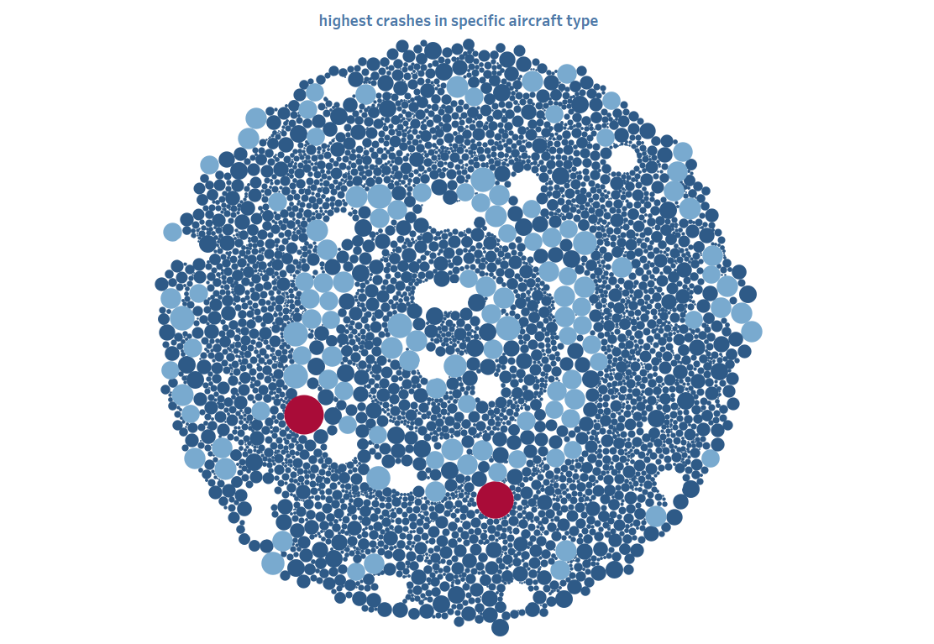
AIRCRAFT ANALYSIS INSIGHT
Highest Crashes in Specific Aircraft Type
In this analysis of airplane crashes, unearthed compelling insights regarding the most frequent occurrences by aircraft type.
Particularly, the Boeing B-747-121/B-747-206B , registered as N736PA, emerged with the highest fatality count, totaling 583.
Following closely behind is the Boeing B-747-SR46, registered as JA8119, with a total fatality count of 520. These findings shed light on critical safety considerations within the aviation industry.

Slide 7
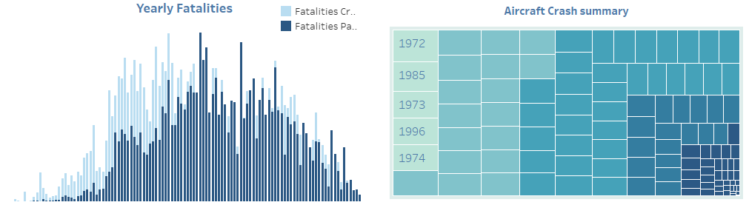
FATILITY TRAND INSIGHTS
Fatality Trends And Airplane Crash Summary
Our findings revealed significant insights: the total number of fatalities, the overall fatality rate, and specific figures for crew and passenger fatalities. Among the data, one striking discovery was an incident with the highest recorded fatality count for crew members, totaling 58, and 179 for passengers, resulting in an overall fatality count of 691. Unfortunately, the year and summary for this tragic event remain unknown.
Additionally, we uncovered an incident dating back to 1899, where the highest number of passengers lost their lives, totaling 560. In this case, 23 crew members also perished, bringing the total fatality count to 583. This incident stands as a stark reminder of the risks involved in air travel.

Slide 8
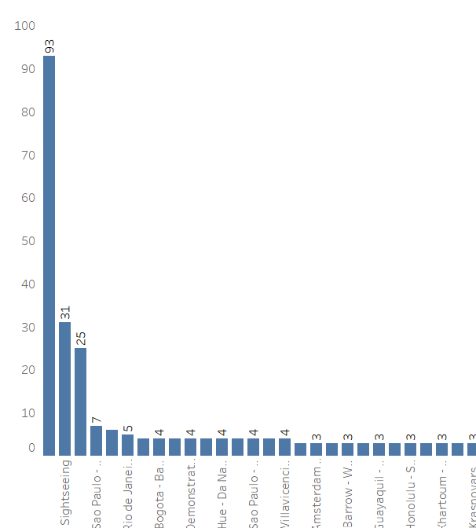
FATILITY TRAND INSIGHTS
Incidents on specific flight route
In the fatality trend analysis the route designated for training flights stood out with the highest number of accidents, involving 93 individuals.
In contrast, sightseeing routes experienced 31 accidents, while the Sao Paulo to Rio de Janeiro route recorded 7 accidents. These findings underscore the importance of route safety protocols in mitigating aviation risks.

Slide 9
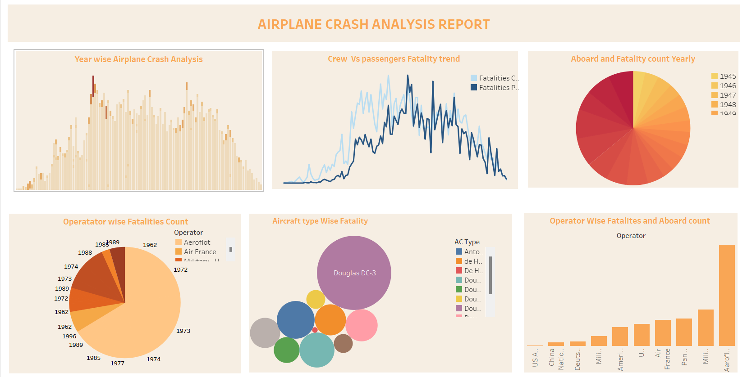
REVIEW Report on operator performance, aircraft involvement, and fatality trends

Slide 10
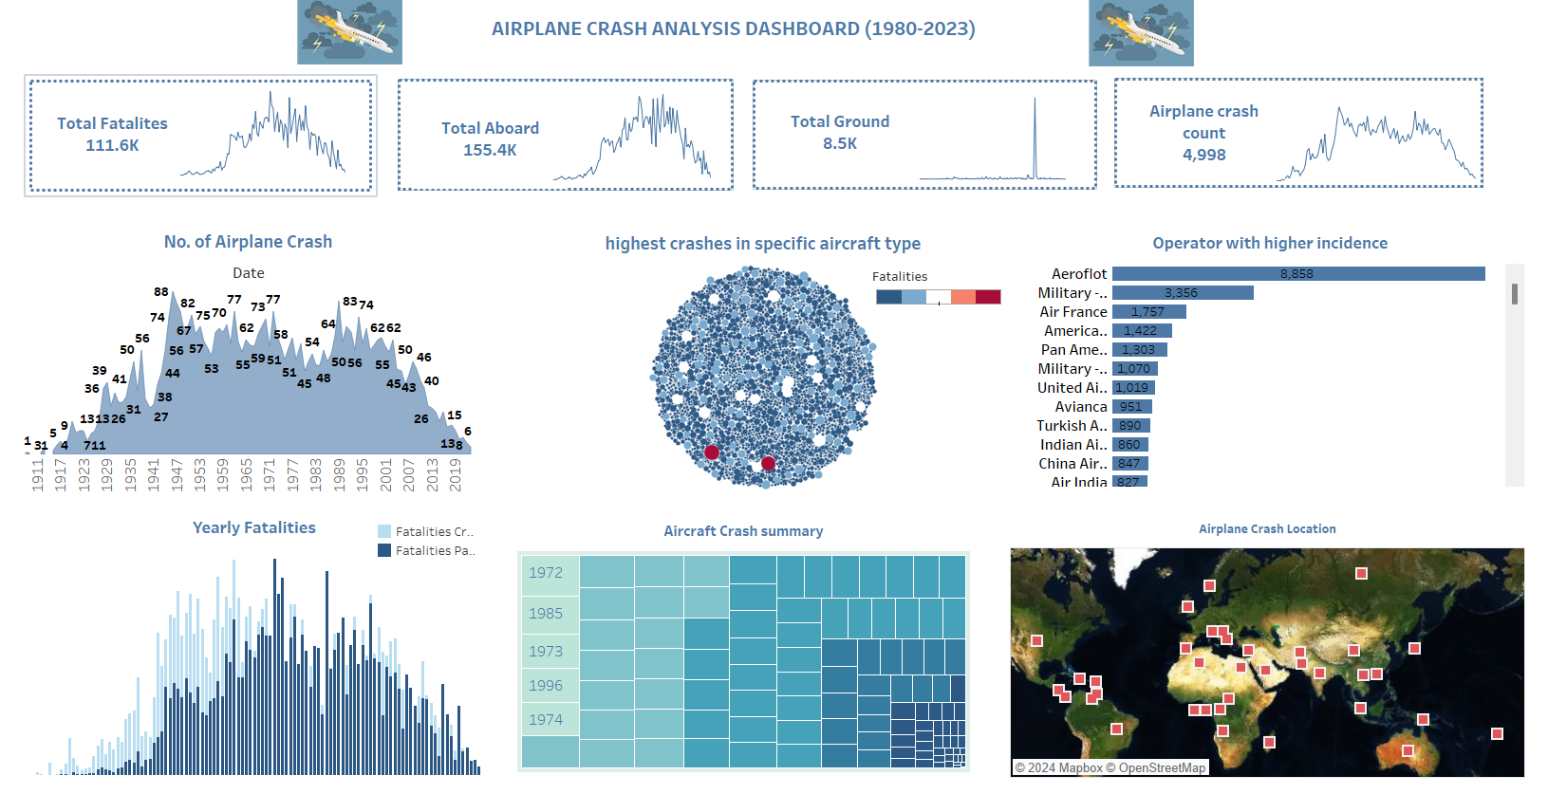

Slide 11
RECOMMENDATION AND RISK FACTORS
Improving aviation safety involves a multifaceted approach that addresses various risk factors. Here are some insights into potential risk factors and recommendations for enhancing aviation safety:
Human factors: human error remains one of the leading causes of aviation accidents. Factors such as fatigue, stress, inadequate training, and poor decision-making can contribute to accidents. Recommendations include:
Implementing comprehensive crew resource management (CRM) training to enhance communication, teamwork, and decision-making skills among flight crews.
Enforcing strict duty hour regulations to mitigate the risks associated with fatigue.
Providing ongoing training and recurrent evaluations to ensure pilots and other aviation personnel maintain proficiency and stay updated on best practices.
Technological factors: while advancements in technology have significantly improved aviation safety, they also introduce new risks, such as automation complacency and system failures. Recommendations include:
Investing in state-of-the-art avionics and automation systems with robust fail-safe mechanisms and redundancy.
Providing thorough training on the use of automation systems and emphasizing the importance of maintaining situational awareness.
Establishing rigorous testing and certification processes for new technologies to identify and mitigate potential risks before widespread implementation.

Slide 12
RECOMMENDATION AND RISK FACTORS
Environmental Factors: Weather conditions and other environmental factors can pose significant risks to aviation safety.
Recommendations include : Enhancing weather forecasting and monitoring capabilities to provide pilots with real-time information on hazardous conditions.
Encouraging the use of alternate routes or delaying flights when adverse weather conditions are present.
Improving airport infrastructure and runway maintenance to minimize the risk of accidents during takeoff and landing, especially in challenging weather conditions.
Regulatory Oversight: Effective regulatory oversight is essential for maintaining high safety standards within the aviation industry.
Recommendations include: Continuously reviewing and updating regulations and standards based on emerging technologies, best practices, and lessons learned from accidents/incidents.
Promoting a culture of safety and accountability within aviation organizations through rigorous oversight and enforcement of regulations.
Enhancing international cooperation and information sharing to address global safety challenges and promote harmonization of safety standards.
Safety Culture: Cultivating a strong safety culture within aviation organizations is crucial for preventing accidents and minimizing risks. Recommendations include:
Fostering open communication and transparency regarding safety issues, incidents, and near misses.
Encouraging proactive hazard reporting and implementing effective safety management systems (SMS) to identify and address potential risks.
Providing incentives and recognition for individuals and teams that demonstrate exemplary safety practices and contribute to a positive safety culture.
By addressing these risk factors and implementing appropriate recommendations, the aviation industry can continue to enhance safety standards and reduce the likelihood of accidents and incidents.

Slide 13
THANK YOU

